Slide 1

Craft Beer
Analysis
Michael Catalano Hayley Horn
Notes:
Beer can be made using a range of ingredients to adjust the color, type and flavor profile. This analysis focuses on two measurements of beer composition, and some geographic details. The first measurement is Alcohol By Volume (ABV) which is a percentage that represents how much of a beer is alcohol versus other ingredients. The other measurement we will consider is International Business Units (IBU) which is measured on a scale of 0 to 100 and describes the bitterness from hops in a beer.

Slide 2
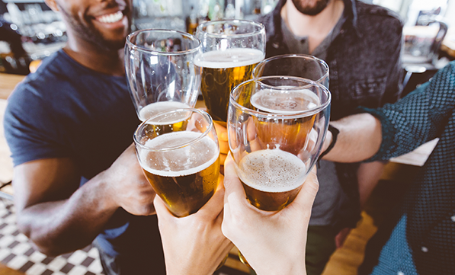
The Big Idea
Analyze regional preferences around bitterness and alcohol content
2
Scope of Analysis
Craft breweries within each state and region
Geographical preference for alcohol content and bitterness (IBUs)
Relationship between the bitterness of the beer and its alcoholic content
Findings
Bitterness of the beer and its alcoholic content don’t always correlate
The state doesn't always determine IBU or ABV percentage – must look at regions
States with low brewery counts can skew the results (West Virginia)
57 percent of Millennials drink craft beer every week in the United States*
*Survey by The Futures Company for the Brewers Association 2016

Slide 3
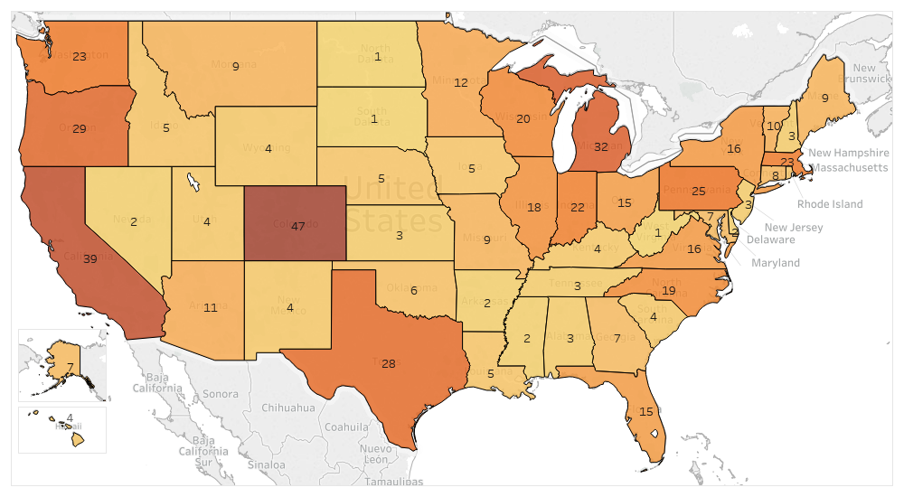
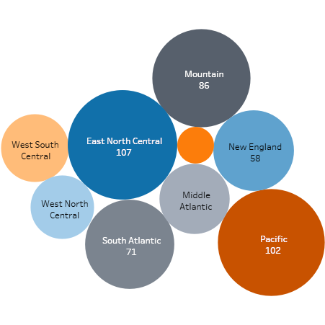
Craft Beer
Breweries by State
3
California and Colorado are the states with the most breweries
At a region level, the East North Central region (Great Lakes) has the highest concentration of breweries, followed by the Pacific region
Notes:
Colorado with 47, and California with 39. You can also see a bubble chart by region, and the amount of breweries within. We can see the East North Central region (Great Lakes states) have the highest numbe of breweries, followed by the Pacific, and Mountain regions.

Slide 4
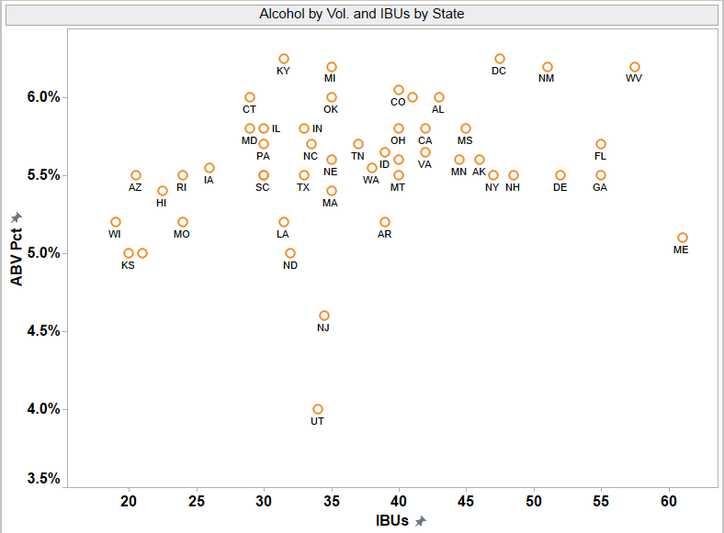
Alcohol Content and Bitterness
Scatter Plot by State
4
4
A
Midwest states like Wisconsin, Kansas, Arizona, Missouri, and Iowa have a lower IBU rating, and lower ABV. Hawaii also has a low IBU rating
D
C
B
B
East coast states like Maine, West Virginia, Florida, Georgia, Delaware, and have higher IBU ratings
A
C
States with lower numbers of breweries may skew the data, or give us other insights (high IBUs don’t necessarily correlate with high ABV in Maine)
D
States with larger number of breweries are found in the middle-range of ABV and IBUs
R² = 0.079
The study showed very little correlation (r = 0.282, p-value = 0.0471) between ABV and IBUs using scatter plot and Pearson's Product correlation formula. Only 8% of the variance of IBUs can be explained by ABV.
Notes:
The scatterplot is usually the first step we’ll take when determining a relationship between two variables, in our case we want to understand if theres a relationship between ABV and IBU, and how that looks at a state-level. From an initial look, without even looking at states, there doesn’t appear to be much of a relationship, kind of looks like a cloud with these data points, no real trend either positive or negative to see. The study showed very little correlation between ABV and IBUs. Only 8% of the variance of IBUs can be explained by ABV, which isnt all that high (more in the appendix if interested). We’ll cover correlation
now lets focus on the states themselves. (read bulleted list)

Slide 5
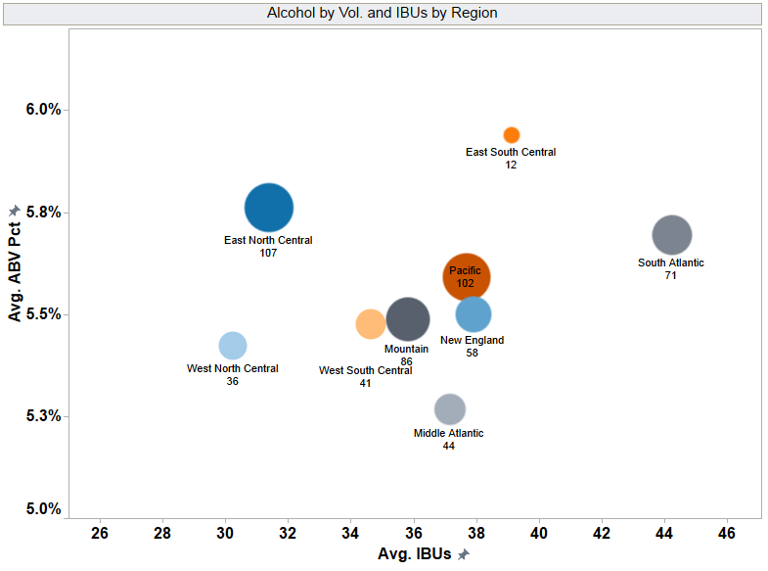
Alcohol Content and Bitterness
Scatter Plot by Region
5
East South Central region has the highest average ABV 5.9%, but the lowest number of breweries (12)
South Atlantic region is “hoppier” with the average 44.3 IBUs
Middle Atlantic region has the lowest ABV at (5.3%, and is midrange in IBU rating 37 IBUs
Notes:
The state few is good to identify stand out states, when you zoom out to a regional view, in this case grouped by census divisions you see regional patterns emerge.
The East South Central region, which includes KY, TN, MS and AL has higher ABVs but fewer breweries.
The South Atlantic region, which includes Florida and Georgia like a hoppier beer.
The Middle Atlantic tends to enjoy a lower ABV, and is ambivalent n hops
West north central

Slide 6
6
APPENDIX

Slide 7
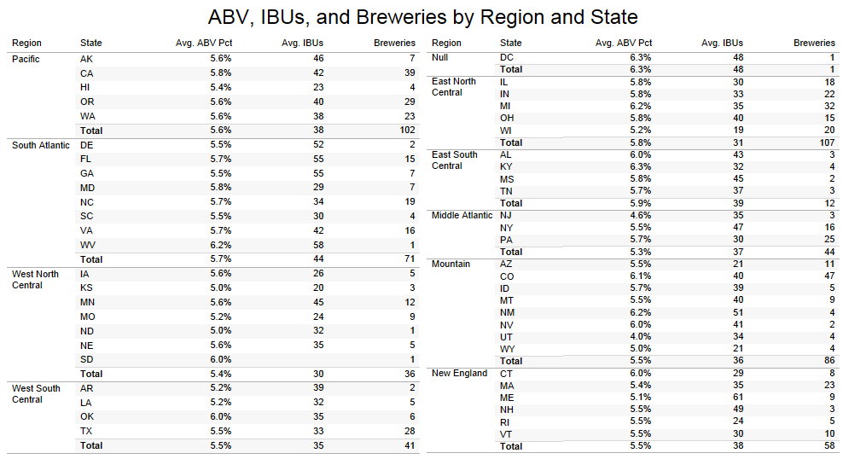
Data Snapshot
7
Notes:
This is a summary view of the ABV%, Average IBU and Count of Breweries by Census Region and State

Slide 8
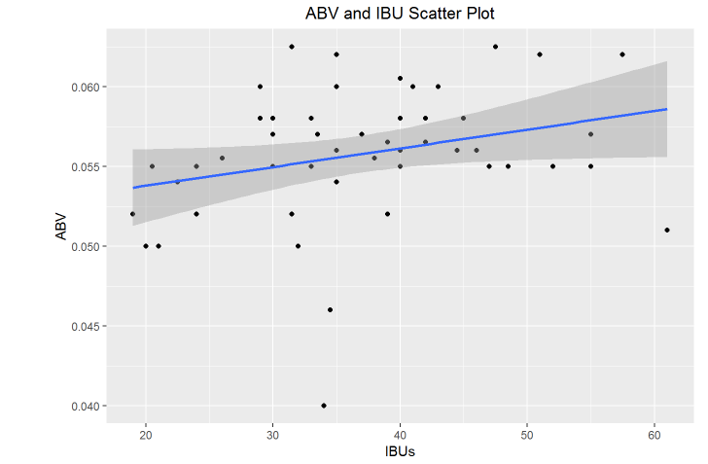
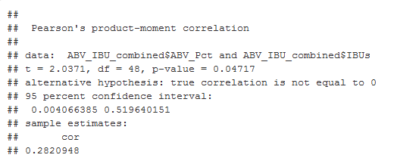
Correlation Analysis
8
The study showed very little correlation (r = 0.282, p-value = 0.0471) between ABV and IBUs using scatter plot and Pearson’s Product correlation formula.
Only 8% of the variance of IBUs can be explained by ABV.
Notes:
Rmarkdown form of ABV and IBU Scatter Plot

Slide 9
Further Research
9
Share of weekly craft beer drinkers in the United States in 2015, by generation
U.S. weekly craft beer drinkers 2015, by generation
Note: United States; 2015; 21 years and older; >10,000; U.S. consumers*
Source(s): Brewers Association; The Futures Company
2

